Slide 1
Human well-being and climate change mitigation
William F. Lamb

Slide 2
Agenda
Welcome to MCC - Brigitte Knopf
Human well-being and climate change mitigation - William Lamb (~50 mins)
Demand-side climate mitigation - Anjali Ramakrishnan (~20 mins)
(Optional) discussion about policies

Slide 3
Well-being theories
How is well-being conceptualised in the literature?
What theoretical claims are deployed?
What metrics or measures are used?
How do different well-being conceptualisations frame climate mitigation goals and strategies?

Slide 4
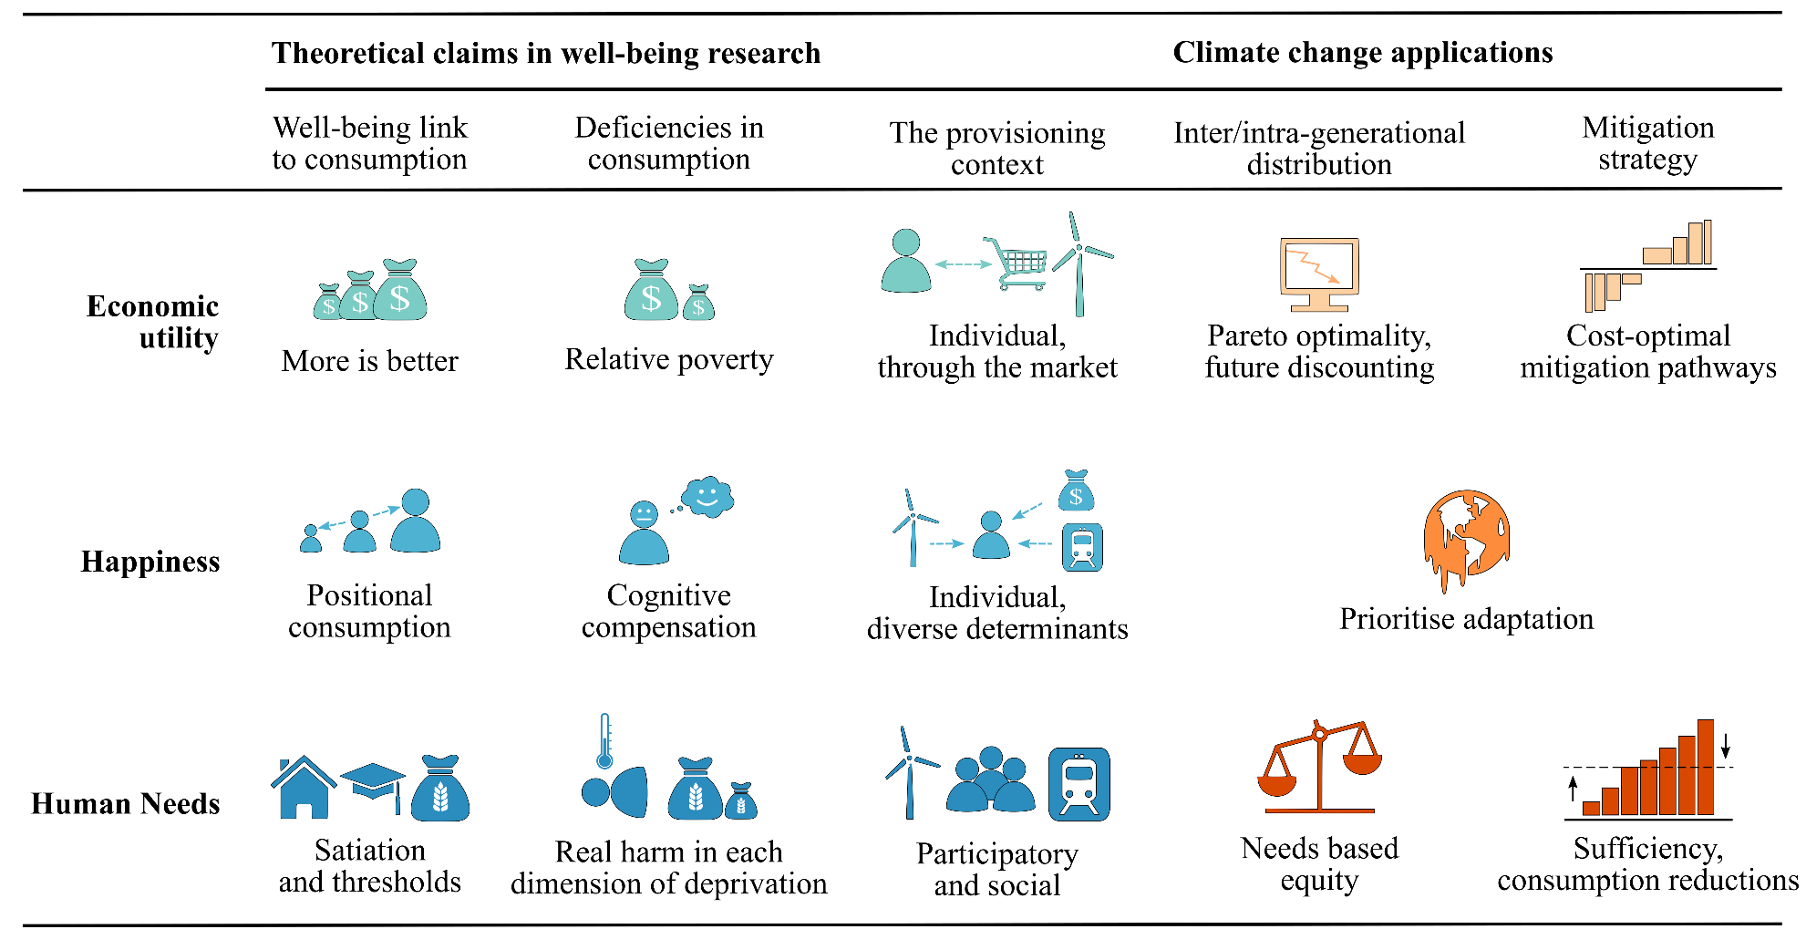
Main claim: well-being theories matter
Lamb W F and Steinberger J K 2017 Human well-being and climate change mitigation Wiley Interdiscip. Rev. Clim. Chang. 8 1–16

Slide 5
Contested definitions and terminology
Well-being Environmental sciences
Welfare Economics
Basic needs Development studies
Human development Development studies
Quality of life Health sciences
Life satisfaction Social psychology
Happiness Economics / psychology

Slide 6
Theoretical categorisation
Preference satisfaction / utility
Hedonic well-being
Eudaimonic well-being
More comprehensive & elaborate categorizations:
Dodds, S. Towards a ‘science of sustainability’: Improving the way ecological economics understands human well-being. Ecol. Econ. 23, 95–111 (1997).
Alkire, S. Dimensions of human development. World Dev. 30, 181–205 (2002).
Gasper, D. Subjective and Objective Well-Being in Relation to Economic Inputs: Puzzles and Responses. Rev. Soc. Econ. 63, 177–206 (2005).

Slide 7
Preference satisfaction / utility theory (1)
Well-being is the satisfaction of wants and desires: ownership or access to goods and services
Also referred to as: welfare, income, living standards
Theoretical claims:
Individuals are best placed to understand their own needs and are able to translate these needs into subjective preferences for different goods
Preferences are primarily satisfied through purchasing and consumption via the market
Individual preference satisfaction can be aggregated and overall social progress measured (GDP growth)
Supports axioms of consumer choice, market delivery of services and GDP as central to human well-being

Slide 8
Preference satisfaction / utility theory (2)
Critiques:
Individuals are not the best and most rational judges of their own needs (drug addiction, gambling)
Preferences are highly adaptive, exposed to market advertising, and influenced by prevailing social and cultural expectations
Humans are cooperative, altruistic, vengeful – contra individual utility
Individual preferences can conflict with others and can generate pervasive “external costs” (owning a firearm vs. living in a gun-free society, driving vs. air pollution, etc.)
Aggregate preferences (GDP) disguise distributional concerns (inequality), resource depletion, etc.
See also
Stiglitz J E, Sen A and Fitoussi J-P 2009 Report by the Commission on the Measurement of Economic Performance and Social Progress
Costanza R, Kubiszewski I, Lovins H, McGlade J, Pickett K E, Ragnarsdottir K V, Roberts D, Vogli R De and Wilkinson R 2014 Time to leave GDP behind Nature 505 283–5

Slide 9

Hedonic well-being (1)
Subjective (mental) account of well-being: pleasure versus pain, feeling good, enjoying life
Also referred to as: happiness, life satisfaction
Theoretical claims:
Individuals are best placed to understand and articulate their own desires (via self-assessments)
A good society is based on individuals maximizing their own happiness (Bentham)
Key Figures: Richard Layard, Ruut Veenhoven, Richard Easterlin

Slide 10
Hedonic well-being (2)
Critiques:
Self-assessments often bear little relation to material deprivation (Sen; adaptive preferences)
Appeals to hedonism have little to say about social aspects of well-being (political life, justice, etc.)
What are the determinants of hedonic well-being?
Economists: income, consumption, employment
Psychologists: mental/biological capabilities
Sociologists: socio-economic conditions, e.g. healthcare provisioning, social capital, political processes
See also
Layard R 2010 Measuring Subjective Well-Being Science (80-. ). 327 534–5
Helliwell J F 2003 How’s life? Combining individual and national variables to explain subjective well-being Econ. Model. 20 331–60

Slide 11

Eudaimonic well-being (1)
Objective (external) account of well-being: activities, abilities, “functionings”
Closely associated with
capabilities (Sen, Nussbaum)
human needs (Max-Neef, Gough)
multidimensional poverty (Alkire)

Slide 12
Eudaimonic well-being (2)
Nussbaum Central Human Capabilities | Max-Neef Axiological categories of human need | Doyal and Gough Intermediate human needs
Life Bodily Health Bodily Integrity Senses, thought, imagination Emotions Practical Reason Affiliation Other species Play Control over one’s environment | Subsistence Protection Affection Understanding Participation Leisure Creation Identity Freedom | Nutritional food/water Protective housing Work Safe physical environment Health care Security in childhood Significant primary relationships Physical security Economic security Safe birth control/childbearing Basic education Critical autonomy
Alkire, S. Dimensions of human development. World Dev. 30, 181–205 (2002).

Slide 13
Eudaimonic well-being (3)
Theoretical claims
How to achieve a cross-cultural consensus on ‘the good life’? Separate human needs/capabilities from their satisfiers
Deficiency in one dimension cannot be compensated by others (multi-dimensional, non-substitutable)
Well-being takes place in the public life - social, cultural, political, economic institutions are relevant
Critiques
Too many dimensions increases complexity, data challenges, and prevents aggregation
Difficult to operationalize in practice and agree on a shared set of policy goals and priorities (inherently political)
See also
Sen, A. (1999). Development as Freedom. Oxford: Oxford University Press.
Nussbaum, M. C. (2000). Women and Human Development: The Capabilities Approach. Cambridge, UK: Cambridge University Press.
Doyal, L., & Gough, I. (1991). A Theory of Human Need. London: Macmillan.

Slide 14
Implications of different theory choices
Well-being is adaptive vs. stable
Intergenerational justice requires eudaimonic accounts, to expose the risk of climate impacts on human health, nutrition, physical safety and other dimensions
Well-being is individual vs. social
Do we target behaviour and choice: educate people to consume less, adapt to climate impacts?
Or also address wider social institutions and challenge contexts that influence demand?
See also
O’Neill, J. (2006). Citizenship, Well-Being and Sustainability: Epicurus or Aristotle? Analyse & Kritik, 28(2), 158–172.
Gough, I. (2015). Climate Change and Sustainable Welfare : An Argument for the Centrality of Human Needs. Cambridge Journal of Economics, 39(5), 1191–1214.

Slide 15
Climate change mitigation
Can we satisfy human needs within climate constraints?
What are the links between human need satisfaction and greenhouse gas emissions?
Is growth in greenhouse gas emissions necessary to raise global well-being?

Slide 16
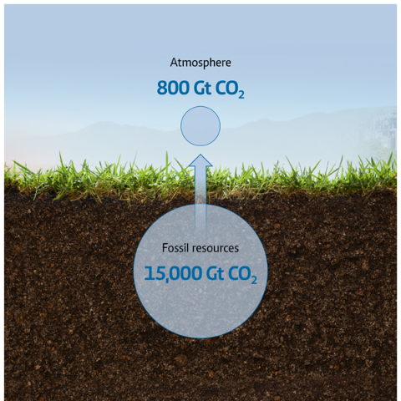
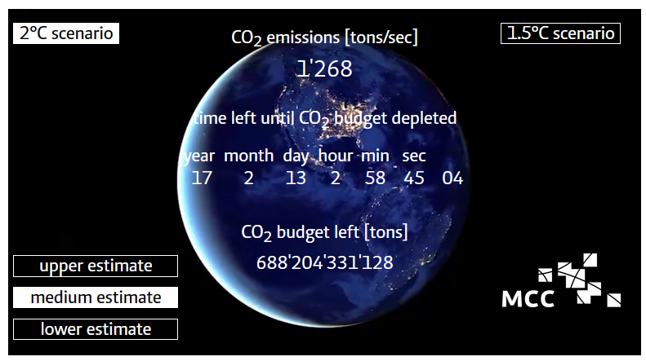
Carbon budgets

Slide 17
What are the links between human need satisfaction and greenhouse gas emissions?

Slide 18
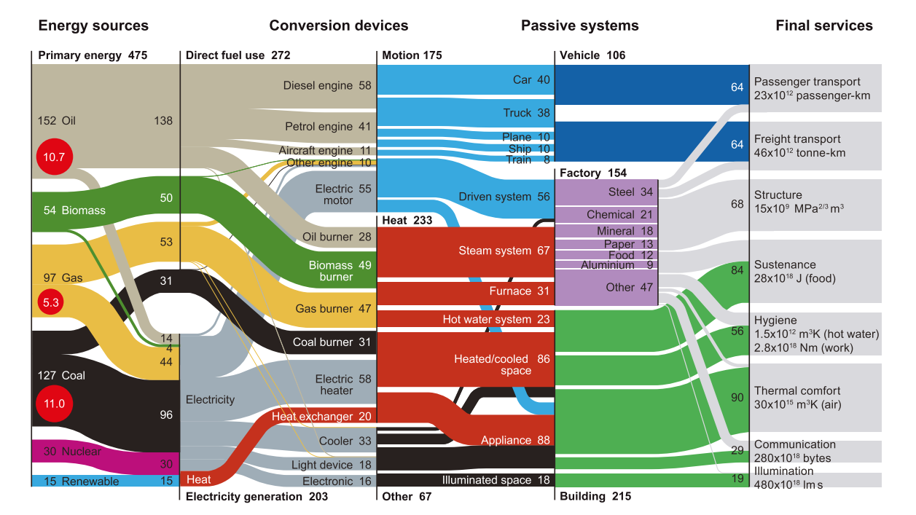
Linking well-being and emissions – via energy
Cullen, J. M., & Allwood, J. M. (2010). The efficient use of energy: Tracing the global flow of energy from fuel to service. Energy Policy, 38(1), 75–81.

Slide 19
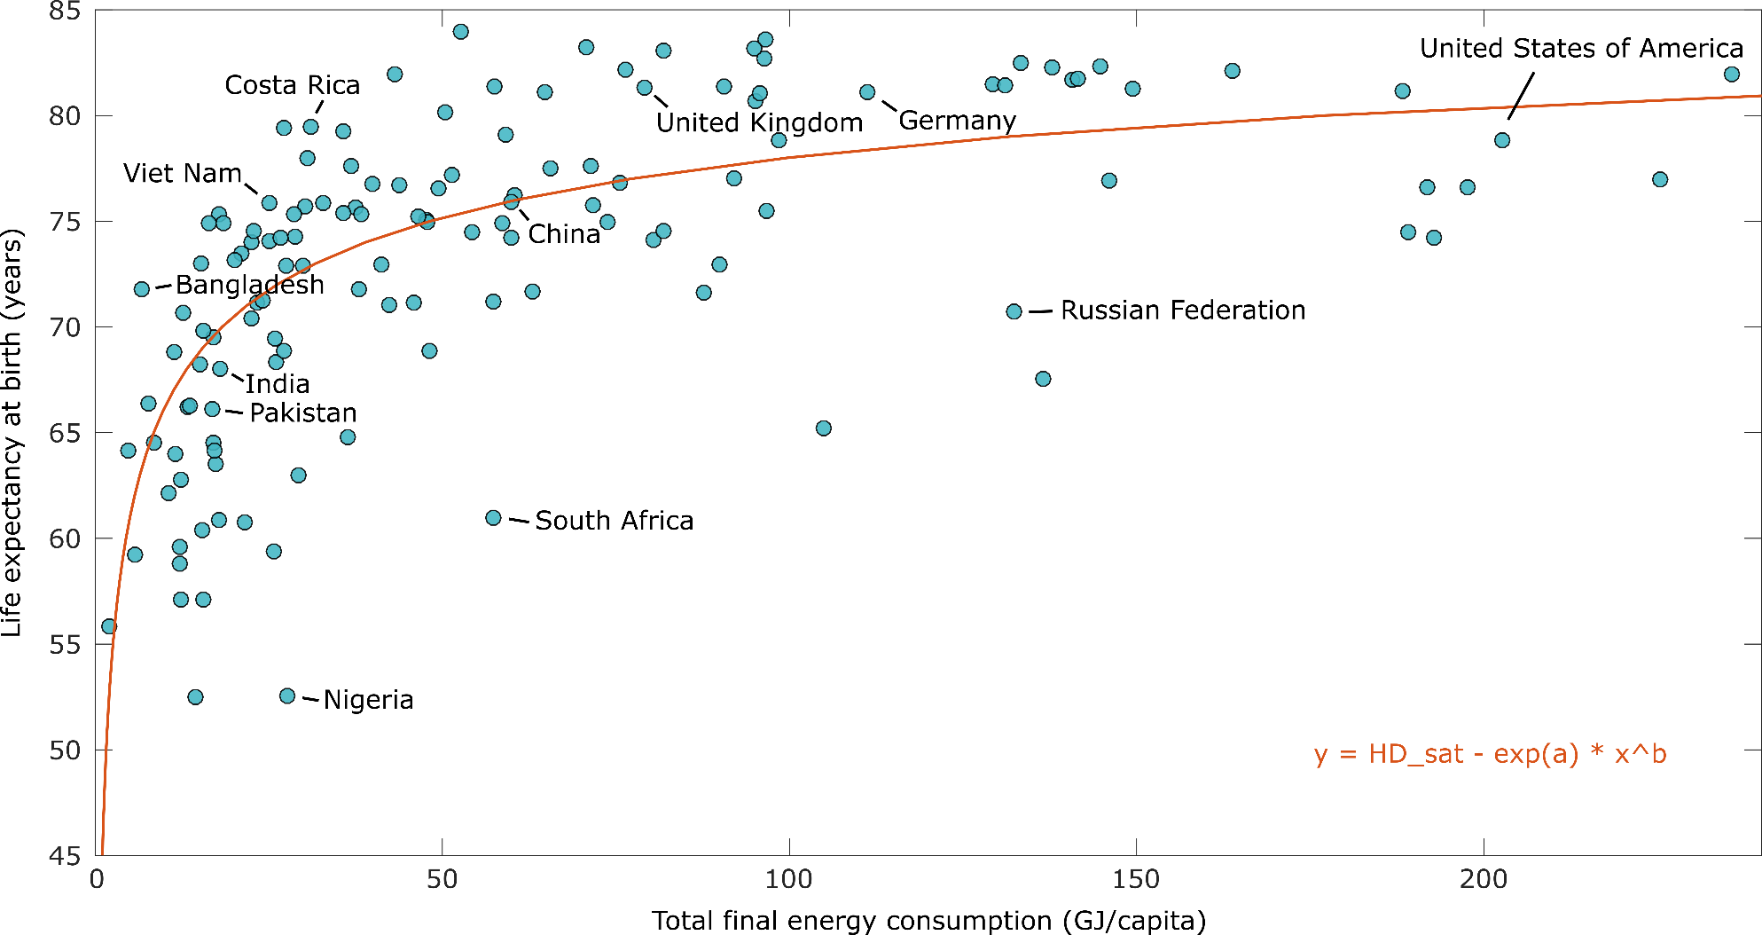
Life expectancy vs. energy consumption (2015)

Slide 20
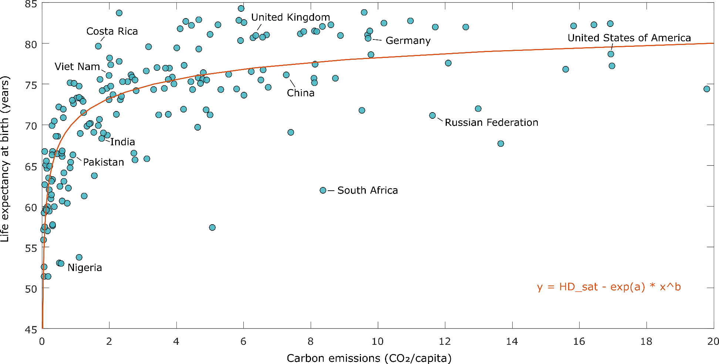
Life expectancy vs. carbon emissions (2015)

Slide 21
Consistent with eudaimonic accounts
Material/energy basis
Decoupling and satiability

Slide 22
Is growth in energy consumption, and GHG emissions, necessary to raise well-being globally?

Slide 23
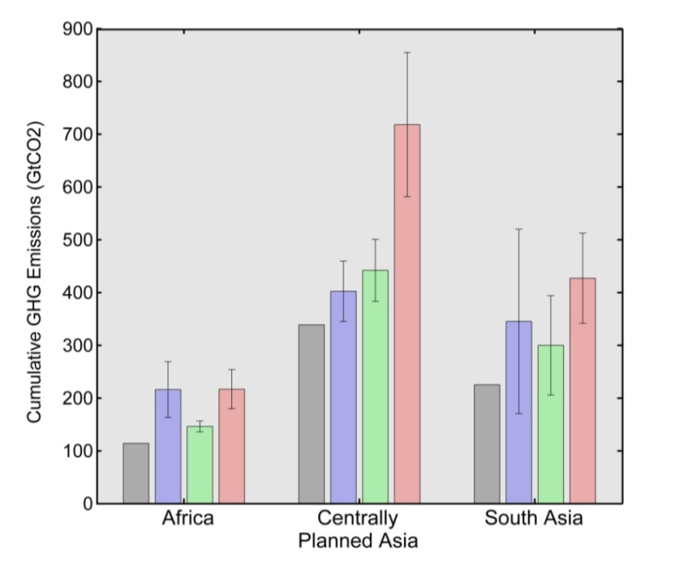




Climate impacts of development
Life expectancy
70 years
Emissions per capita
Lamb W F and Rao N D 2015 Human development in a climate-constrained world: What the past says about the future Glob. Environ. Chang. 33 14–22

Slide 24
What about other dimensions of well-being, and environmental impact?
Are countries achieving good well-being at a low impact?

Slide 25
Multi-dimensional well-being goals
Social Indicators and their Thresholds
Social Indicator | Threshold
Life Satisfaction | 6.5 on 0–10 Cantril ladder scale
Healthy Life Expectancy | 65 years
Nutrition | 2700 kcal per capita
Sanitation | 95% of people have access to improved sanitation facilities
Income | 95% of people earn above $1.90 a day
Access to Energy | 95% of people have electricity access
Education | 95% enrolment in secondary school
Social Support | 90% of people have friends or family they can depend on
Democracy | 0.80 (approximate US/UK value)
Equality | 70 on 0–100 scale (GINI index of 0.30)
Employment | 94% employed (6% unemployment)
Human
Well-being
Need
Satisfiers

Slide 26


Downscaled planetary boundaries
Equal per capita
Planetary boundaries
National allocation
Biophysical Indicator | Planetary Boundary | Per Capita Boundary
CO₂ Emissions | 2 °C warming | 1.61 t CO₂ y⁻¹
Phosphorus | 6.2 Tg P y⁻¹ | 0.89 kg P y⁻¹
Nitrogen | 62 Tg N y⁻¹ | 8.9 kg N y⁻¹
Blue Water | 4000 km³ y⁻¹ | 574 m³ y⁻¹
eHANPP | 18.2 Gt C y⁻¹ | 2.62 t C y⁻¹
Ecological Footprint |  | 1.72 gha y⁻¹
Material Footprint |  | 7.2 t y⁻¹

Slide 27
Multiple dimensions
O’Neill D W, Fanning A L, Lamb W F and Steinberger J K 2018 A good life for all within planetary boundaries Nat. Sustain.

Slide 28
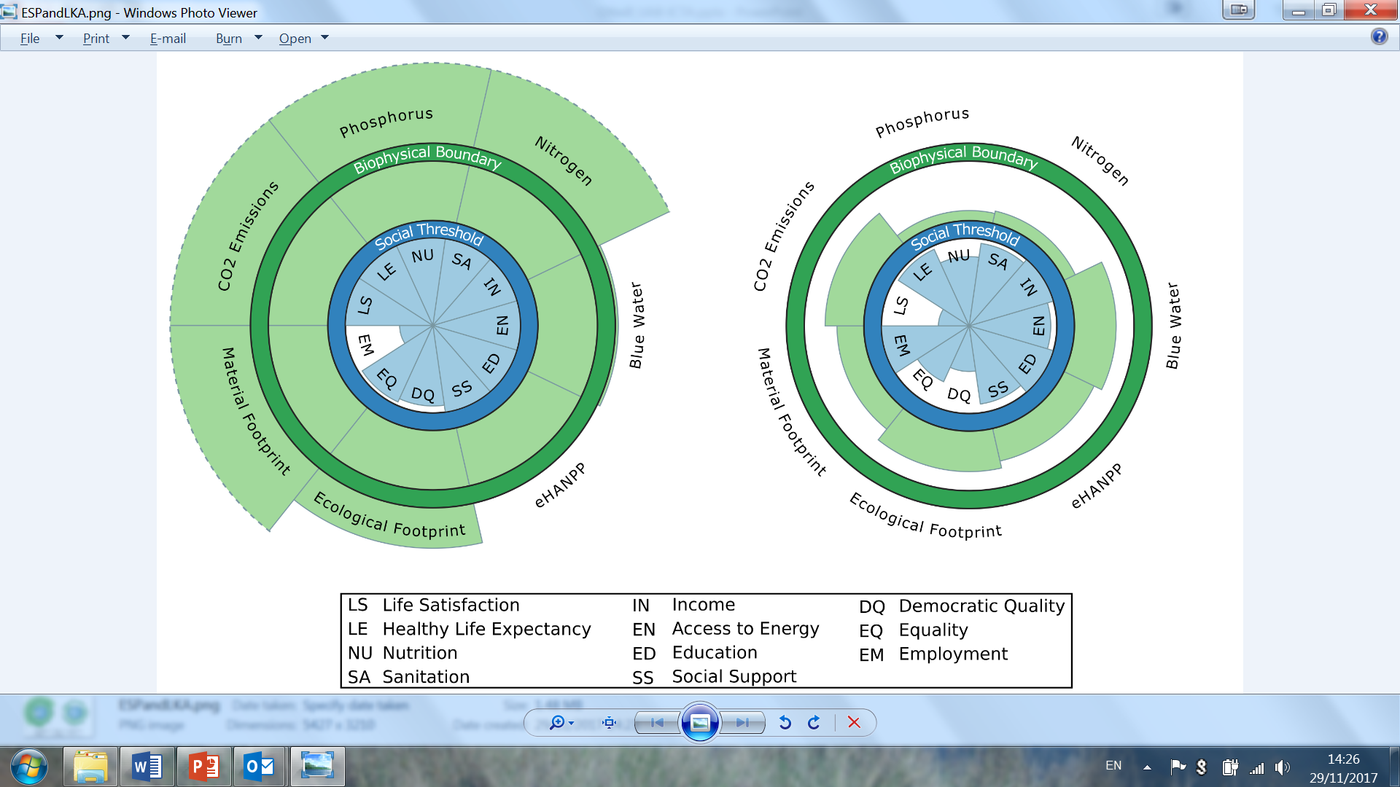
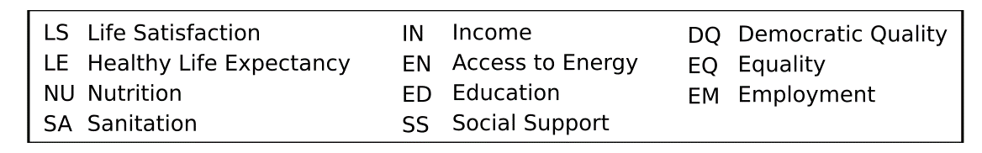
Planetary boundaries and well-being (1)
Spain
Sri Lanka
O’Neill D W, Fanning A L, Lamb W F and Steinberger J K 2018 A good life for all within planetary boundaries Nat. Sustain.

Slide 29
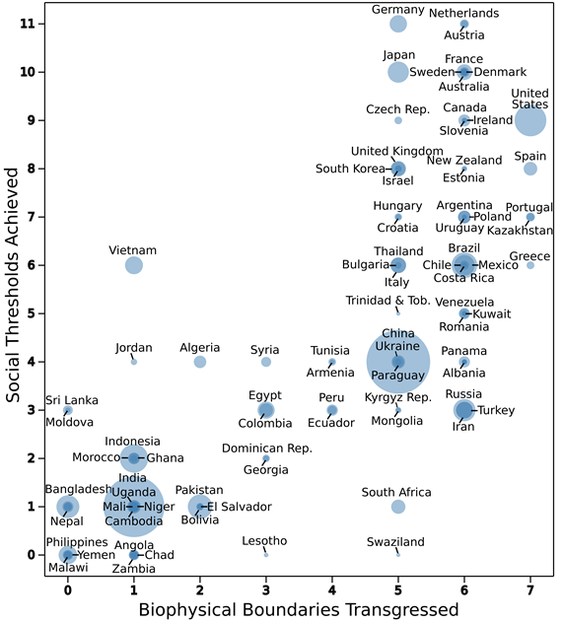
Planetary boundaries and well-being (2)
O’Neill D W, Fanning A L, Lamb W F and Steinberger J K 2018 A good life for all within planetary boundaries Nat. Sustain.
Notes:
What is conclusion here?

Slide 30
Minimum consumption
Deficiencies in consumption result in real harm in each dimension of deprivation (eudaimonic accounts)
How much is enough?
Minimum ‘basic needs’ accounts suggest ~30 GJ/capita (Lamb & Rao 2015)
Bottom-up studies in preparation (see Rao & Min 2018)
Emphasis on procedural approaches, matching expert and local knowledge (Doyal and Gough 1991)
Lamb W F and Rao N D 2015 Human development in a climate-constrained world: What the past says about the future Glob. Environ. Chang. 33 14–22
Rao N D and Min J 2017 Decent Living Standards: material prerequisites for human wellbeing Soc. Indic. Res.
Doyal L and Gough I 1991 A Theory of Human Need (London: Macmillan)

Slide 31
Maximum consumption
Well-being link to consumption is characterised by thresholds and decoupling
Prioritise the material dependency of human need in the management of global commons?
Strong ethical arguments: subsistence vs. luxury emissions (Shue 1993)
“the only freedom which deserves the name, is that of pursuing our own good in our own way, so long as we do not attempt to deprive others of theirs, or impede their efforts to attain it.” (J.S. Mill, own emphasis; see Vanderheiden 2009)
Identify and constrain consumption pathologies
Meat consumption, health, and environmental limits (Springmann et al 2018)
Urban transport, health, air pollution and accident risks (Woodcock et al 2009)
Shue H 1993 Subsistence Emissions and Luxury Emissions Law Policy 15 39–59
Vanderheiden S 2009 Allocating ecological space J. Soc. Philos. 40 257–75
Springmann M et al 2018 Options for keeping the food system within environmental limits Nature
Woodcock J et al Public health benefits of strategies to reduce greenhouse-gas emissions: urban land transport Lancet 374 1930–43

Slide 32
Provisioning context
The provisioning context is participatory and social
Lower the material and resource requirements of human need satisfaction
Technology focus: “Low energy demand” scenarios (Grübler et al. 2018)
Practice focus: everyday habits and routines (Shove & Walker 2014)
System focus: infrastructures and social systems constrain choice (Mattioli 2016)
Grubler A et al 2018 A low energy demand scenario for meeting the 1.5oC target and sustainable development goals without negative emissions technologies Nat. Energy 3 515–27
Shove E and Walker G 2014 What Is Energy For? Social Practice and Energy Demand Theory, Cult. Soc. 31 41–58
Mattioli G 2016 Transport needs in a climate-constrained world. A novel framework to reconcile social and environmental sustainability in transport Energy Res. Soc. Sci. 18 118–28

Slide 33
Thanks!
Lamb W F and Steinberger J K 2017 Human well-being and climate change mitigation Wiley Interdiscip. Rev. Clim. Chang. 8 1–16

Slide 34
Policies for human well-being and climate change mitigation
William F. Lamb

Slide 35
Frameworks to assess policies
Effectiveness
GHG mitigation potential
Well-being outcomes
Feasibility
Vested interests
Distributional impacts
Institutional aspects
Consequences and sequencing
Policies make new politics

Slide 36



Carbon taxes
Compensation
Low-carbon technologies
Revenues
Climate policy
(e.g. carbon taxes)
Poverty alleviation

Slide 37
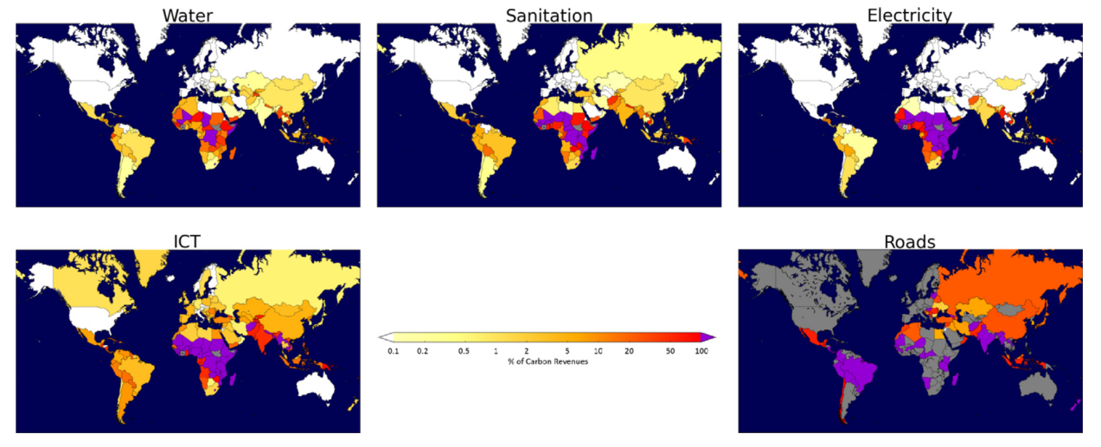
Funding basic needs
Example: India could raise ~$115 bn per year from a carbon tax. Just 4% of this could fund universal access to improved sanitation facilities.
Jakob M, Chen C, Fuss S, Marxen A, Rao N D and Edenhofer O 2016 Carbon Pricing Revenues Could Close Infrastructure Access Gaps World Development (2016)

Slide 38
Climate mitigation policy - scope
Climate focused
Carbon tax
Standards and regulations (e.g. vehicle emissions)
Broader
Green new deal
Ecological tax reform
Working time reduction
Social consumption (housing, transport, food)
Regulate advertising
Etc.

Slide 39
Key questions
Should we take a narrow (climate focused) or broad (well-being focus) scope in climate policy?
How do we disable opposing interest groups?
What is the appropriate sequence of policies to build support and momentum?

Slide 40
Thanks!

Slide 41
Eudaimonic well-being (4)
Well-being
Physical health
Autonomy
Mental health
Safe environment
Healthcare
Relationships
Education
Food & water
Childhood security
Economic security
Doyal, L., & Gough, I. (1991). A Theory of Human Need. London: Macmillan.

Slide 42
Linking human need satisfaction and GHG emissions
BIOPHYSICAL RESOURCE USE
PROVISIONING
SYSTEMS
SOCIAL OUTCOMES
Planetary Processes
Carbon cycle,
Hydrological cycle,
Biogeochemical cycles,
Land-system change,
…
Natural Resources
Energy,
Water,
Materials,
Land,
…
Physical:
Infrastructure, Technology,
Manufacturing,
…
Social:
Government, Communities, Markets,
…
Need
Satisfiers
Food,
Clean water,
Income,
Education,
Relationships,
Equality,
Employment,
…
Human
Well-being
Life satisfaction,
Health,
…
O’Neill D W, Fanning A L, Lamb W F and Steinberger J K 2018 A good life for all within planetary boundaries Nat. Sustain.

Slide 43
Paternalism
Version 1
Argument: It is not the role of scientists/policy makers to decide what people want/need. Consumer/individual sovereignty should be the priority.
Response: Needs can be separated from satisfiers (Nussbaum, Sen, Gough). Needs are universal, satisfiers are individual/cultural.
Counterfactual: Consumer sovereignty is influenced by a constellation of media, corporate and political power. Not choosing to define human well-being using scientific, procedural and democratic means allows powerful interests to do so instead – to their own benefit (Marx: “The ideas of the ruling class are in every epoch the ruling ideas”).
Version 2
Argument: Needs are relative, historical and socially constructed; humans cannot converge on a set of universal objective goals.
Response: Rawls disagrees (veil of ignorance).
Counterfactual: It is impossible for humans to agree on any goals of collective and common interest.

Slide 44
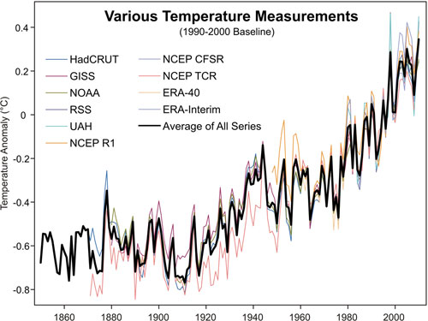
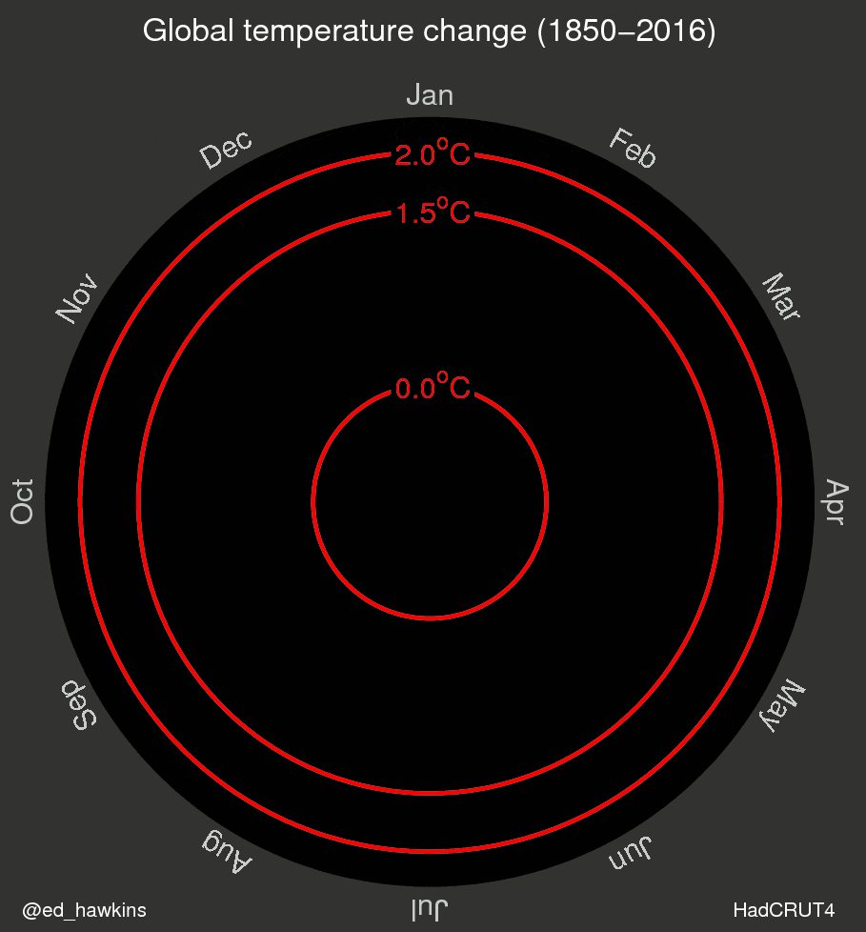
Observational trend in global temperature change
Temperature trends are compiled from multiple sources:
Surface thermometers (NASA GISS, NOAA, and HadCRUT)
Satellite data (RSS, UAH)
Composite data from stations, aircraft, radiosonde, bouys & ships (NCEP, ERA)

